Slide 1
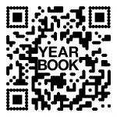
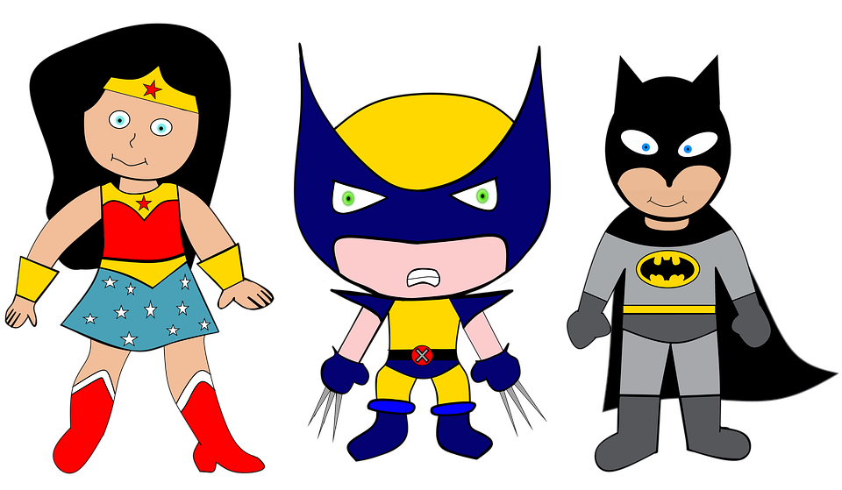
We are SUPERheroes! Students Using their Powers to Engage in Reading!
Kindergarten Newsletter – March 7-11, 2022
IMPORTANT EVENTS
Breakfast ends at 7:25!
3/10 3/14-3/18 | Spring Pictures Spring Break
The EXPERT in anything was once a BEGINNER!
HOMEWORK
Mon. – Thurs. | Weekly ELA Sheet Math HW Pages Practice Sight Words List Read 10 minutes per night
WEEKLY ASSESSMENTS
ELA | Module 7.1 Listening test Oral Reading Fluency test Primer sight words test Writing test Spelling Test ( dig, wig, cot, men, get, sun, fun)
Math | Test on number id to 20, counting to 50 and counting from a given number to 50
SCHOOL NEWS
Don’t forget you can order yearbooks online. Our new Phonics program starts promptly at 7:45 a.m. everyday, so be sure your child is here before 7:30 a.m. We don’t want them to miss a minute of learning!
WEEKLY MATH SKILLS
Unknown number Writing 1,2,3,4,5,6,7,8,9,10 Teen numbers Decompose numbers 3-10 Adding/subtracting to 10
REMINDERS
Please make sure all money is sent in your child’s blue folder labeled and sealed. If your child is absent, please send an excuse labeled with the following information: Child’s name, date of absence, teacher’s name, and reason for absence.
SCHOOL SAFETY
Be sure your child wears a mask to school DAILY!

Slide 2
Module 7 Week 1: Zoom In!
LEARNING MINDSET: Noticing
ESSENTIAL QUESTION
What can I learn when I look closely?
PHONICS
Introduce: double consonants & L blends, ish word fam.
READING
Genre: Fiction Story Elements: Characters, Settings, Events Informational Texts | Listening Comprehension Parts of a Book Collaborative discussions
WORDS TO KNOW
Down Off So will
VOCABULARY
BIG IDEA WORDS: Watch, wonder, world POWER WORDS: familiar, free, witness Books: Last Stop on Market Street and Not a Box
REVIEW
Letters and sounds Aa-Ff Gg-Pp Qq-Zz
WRITING
Nouns and Verbs Characters/Setting Narratives
SPELLING WORDS
dig wig cot men get sun fun
PHONEMIC AWARENESS
Identify Rhymes Identify Syllables Beg., Medial, Final Sounds

